Slide 1
Law of Large Numbers and Central Limit Theorem
Shovan Bhowmik
Lecturer
Dept. of CSE, BAIUST

Slide 2
Law of Large Numbers
It has a very central role in probability and statistics
It states that if you repeat an experiment independently a large number of times and average the result, what you obtain should be close to the expected value that means mean value.
The law of large numbers is a principle of probability according to which the frequencies of events with the same likelihood of occurrence even out, given enough trials or instances. As the number of experiments increases, the actual ratio of outcomes will converge on the theoretical, or expected, ratio of outcomes.

Slide 3
Law of Large Numbers(Cont..)
As the number of trials or observations increases, the actual or observed probability approaches the theoretical or expected probability.
For example, if a fair coin (where heads and tails come up equally often) is tossed 1,000,000 times, about half of the tosses will come up heads, and half will come up tails. The heads-to-tails ratio will be extremely close to 1:1. However, if the same coin is tossed only 10 times, the ratio will likely not be 1:1, and in fact might come out far different, say 3:7 or even 0:10.
The LLN is important because it guarantees stable long-term results for the averages of some random events.

Slide 4
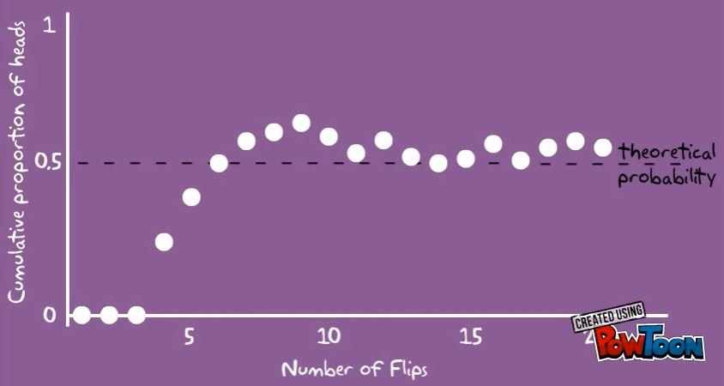
Law of Large Numbers(Cont..)
Let’s observe the following graph:

Slide 5


Law of Large Numbers(Cont..)
There are two different versions of LLNs.
Weak Law of Large Numbers(WLLNs)
Strong Law of Large Numbers(SLLNs)
For both cases, lets say X_{1,} X_{2,} …….. , X_{n} be the independent, identically distributed(iid) random variables where the mean of the population E(X_{i}) = ^{µ}
Converges to the expected value

Slide 6
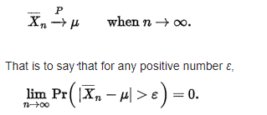
Weak Law of Large Numbers(WLLNs)
This states that the sample average converges in probability towards the expected value.
Interpreting this result, the weak law essentially states that for any non-zero margin specified, no matter how small, with a sufficiently large sample there will be a very high probability that the average of the observations will be close to the expected value that is within the margin.

Slide 7
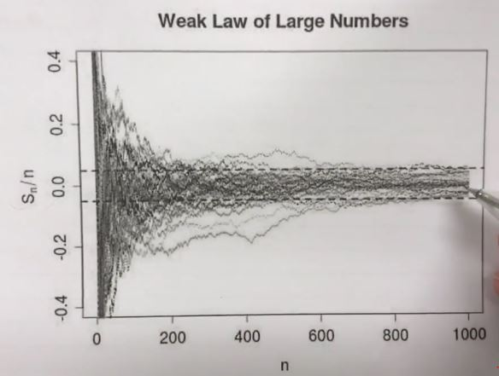
Weak Law of Large Numbers(WLLNs)(Cont..)

Slide 8
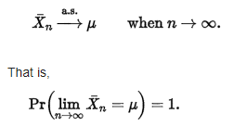
Strong Law of Large Numbers(SLLNs)
It states that the sample average converges almost surely to the expected value.
What this means is that as the number of trials n goes to infinity, the probability that the average of the observations is equal to the expected value will be equal to one.

Slide 9
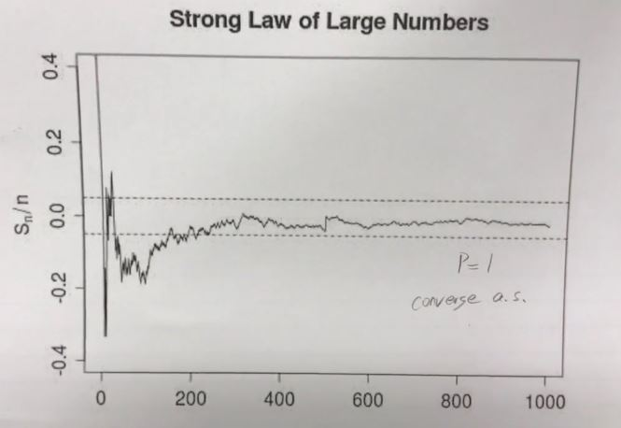
Strong Law of Large Numbers(SLLNs)(Cont..)

Slide 10
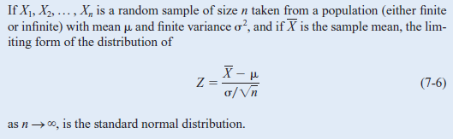

Central Limit Theorem
The sample size n = 30 is a guideline to use for the Central Limit Theorem.
The normal approximation for $\overline{X }$will generally be good if n ≥ 30, provided the population distribution is not terribly skewed.
If n < 30, the approximation is good only if the population is not too different from a normal distribution.

Slide 11
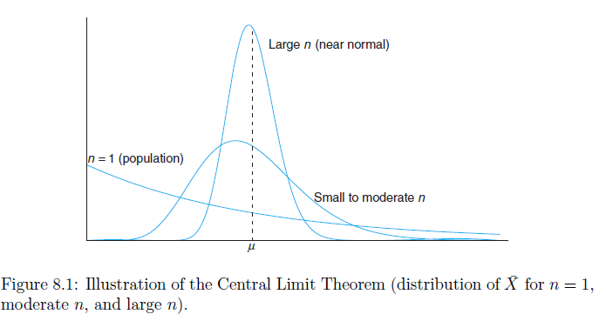

Central Limit Theorem(Cont..)
The mean of $\overline{X }$remains μ for any sample size and the variance of $\overline{X }$gets smaller as n increases.

Slide 12
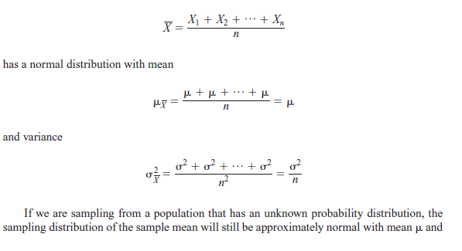

Central Limit Theorem(Proof)
Suppose that a random sample of size n is taken from a normal population with mean $μ$ and variance$σ^{2}$. Now each observation in this sample, say, X1, X2, …, Xn, is a normally and independently distributed random variable with mean $μ$ and variance $σ^{2}$. The sample mean is:
variance $\frac{σ^{2}}{n}$, if the sample size n is large. This is one of the most useful theorems in statistics, called the central limit theorem.

Slide 13
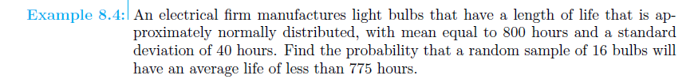
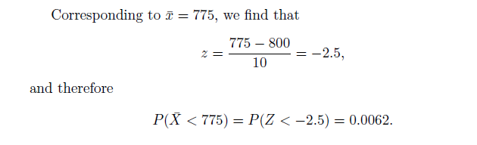
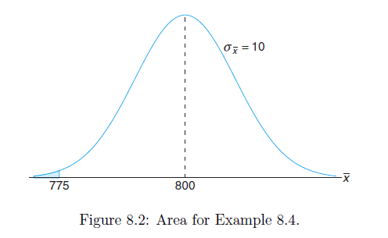
Central Limit Theorem(Math)

Slide 14


